Slide 3
Holy Holy Holy
Page# 47
By PresenterMedia.com

Slide 4
1-1 Holy, Holy, Holy
Holy, Holy, Holy
47

Slide 5
1-2 Holy, Holy, Holy
Holy, Holy, Holy
47

Slide 6
2-1 Holy, Holy, Holy
Holy, Holy, Holy
47

Slide 7
2-2 Holy, Holy, Holy
Holy, Holy, Holy
47

Slide 8
3-1 Holy, Holy, Holy
Holy, Holy, Holy
47

Slide 9
3-2 Holy, Holy, Holy
Holy, Holy, Holy
47

Slide 10
4-1 Holy, Holy, Holy
Holy, Holy, Holy
47

Slide 11
4-2 Holy, Holy, Holy
Holy, Holy, Holy
47

Slide 12
Scripture & Prayer
Galatians 2:20

Slide 13
Christ Arose
Page# 344
By PresenterMedia.com

Slide 14
1 Low in the Grave He Lay
Low in the Grave He Lay
344

Slide 15
2 Low in the Grave He Lay
Low in the Grave He Lay
344

Slide 16
3 Low in the Grave He Lay
Low in the Grave He Lay
344

Slide 17
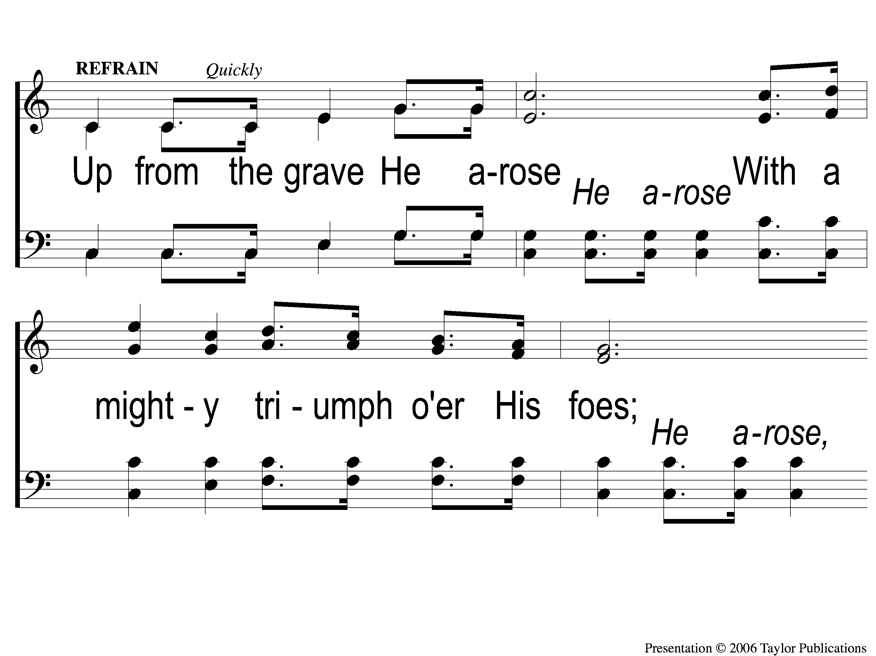
C-1 Low in the Grave He Lay
Low in the Grave He Lay
344

Slide 18
C-2 Low in the Grave He Lay
Low in the Grave He Lay
344

Slide 19
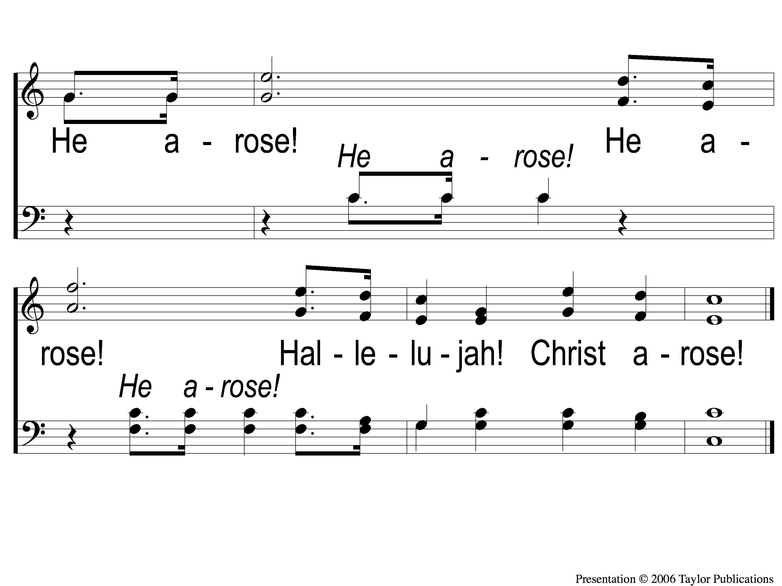
C-3 Low in the Grave He Lay
Low in the Grave He Lay
344

Slide 21
What Your Giving Is Doing... THE PREACHING OF THE GOSPEL

Slide 22
Sing To me of Heaven
Page# 716
By PresenterMedia.com

Slide 23
1-1 Sing to Me of Heaven
Sing To Me of Heaven
716

Slide 24
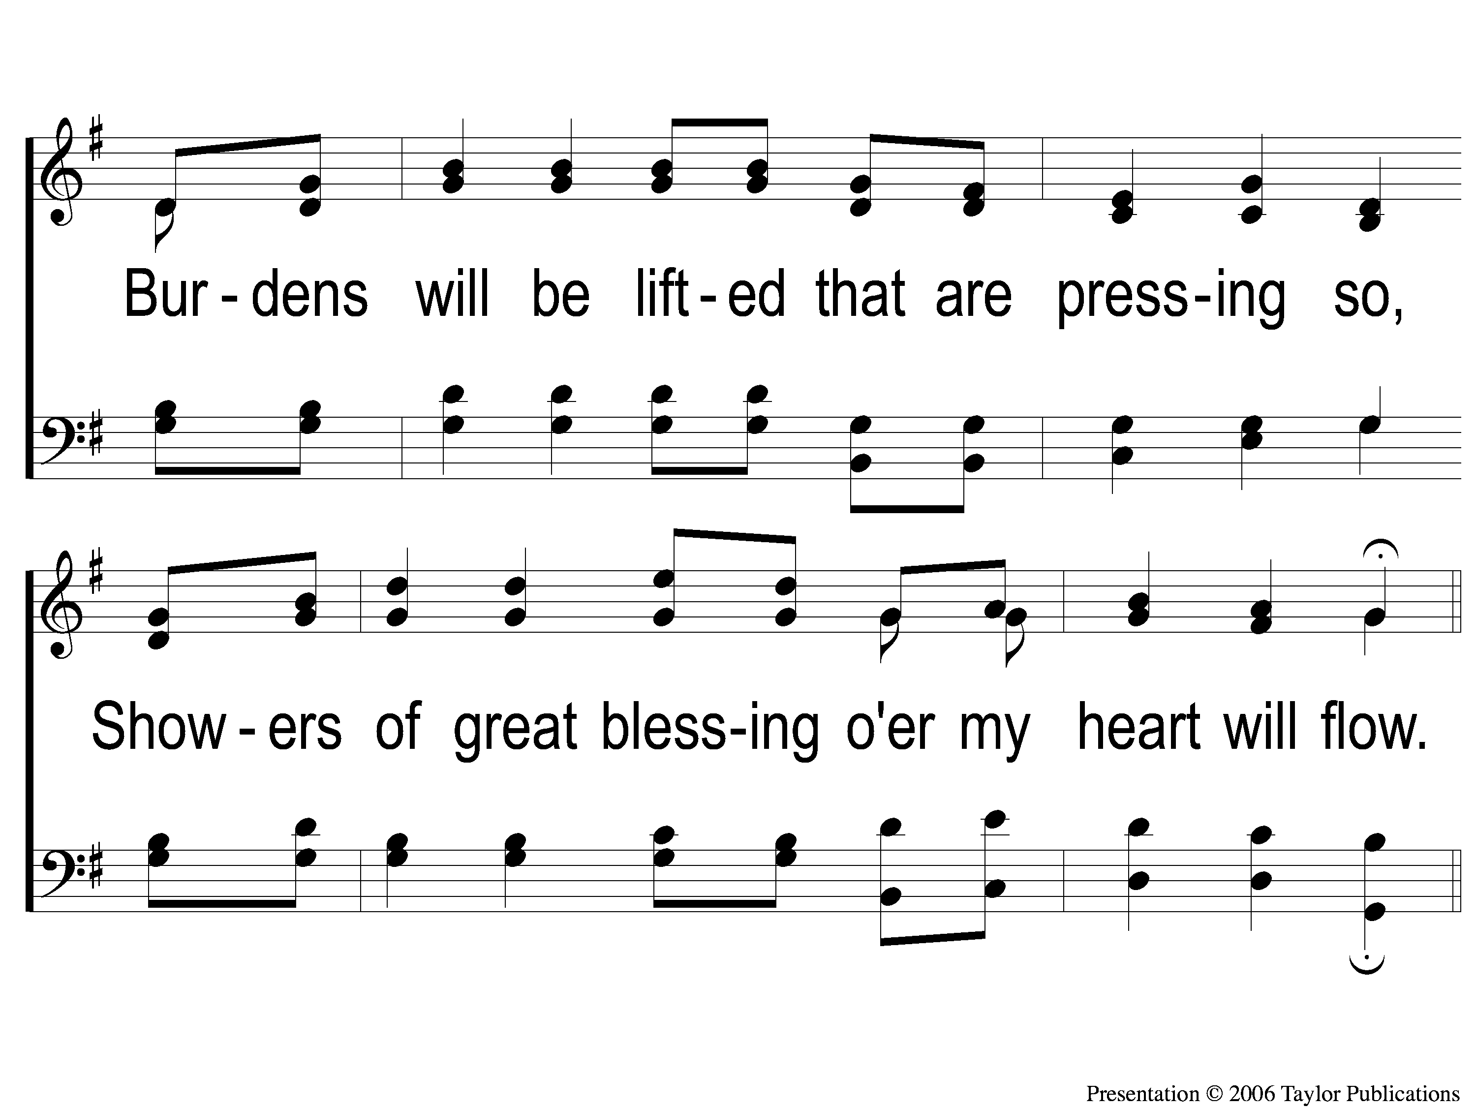
1-2 Sing to Me of Heaven
Sing To Me of Heaven
716

Slide 25
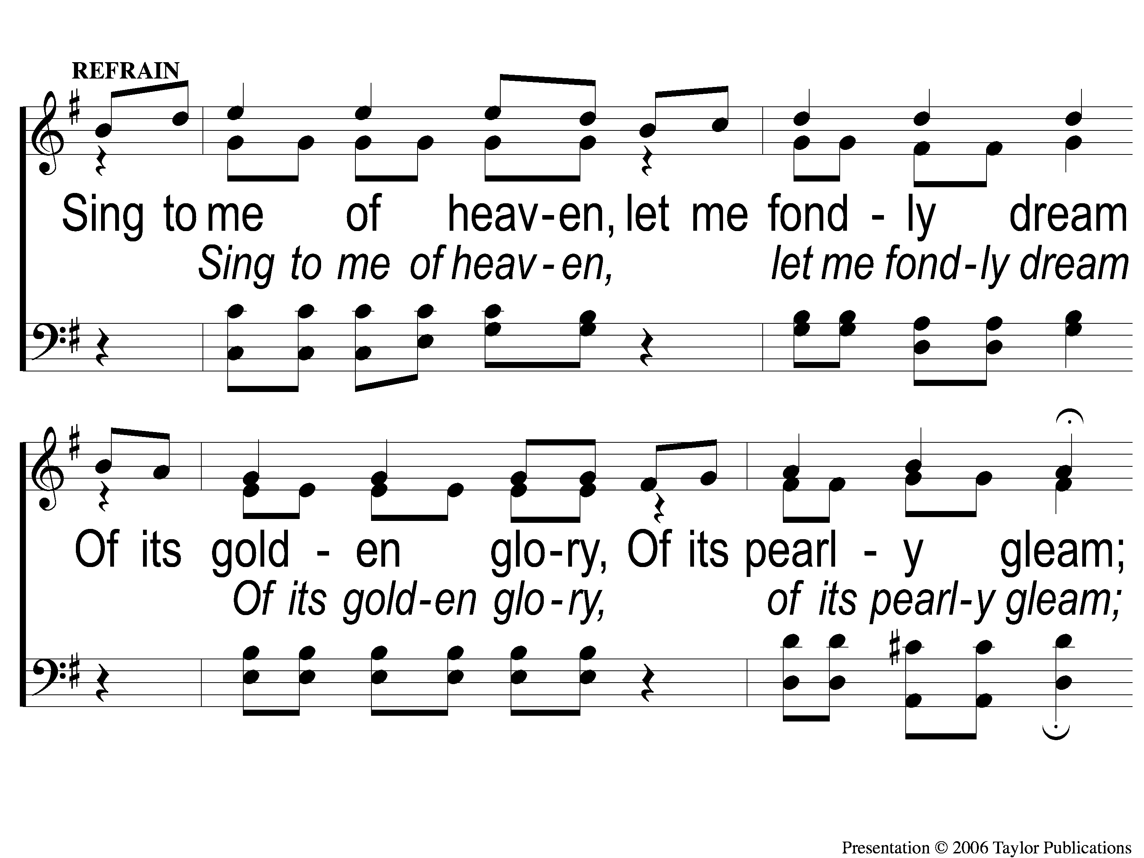
C-1 Sing to Me of Heaven
Sing To Me of Heaven
716

Slide 26
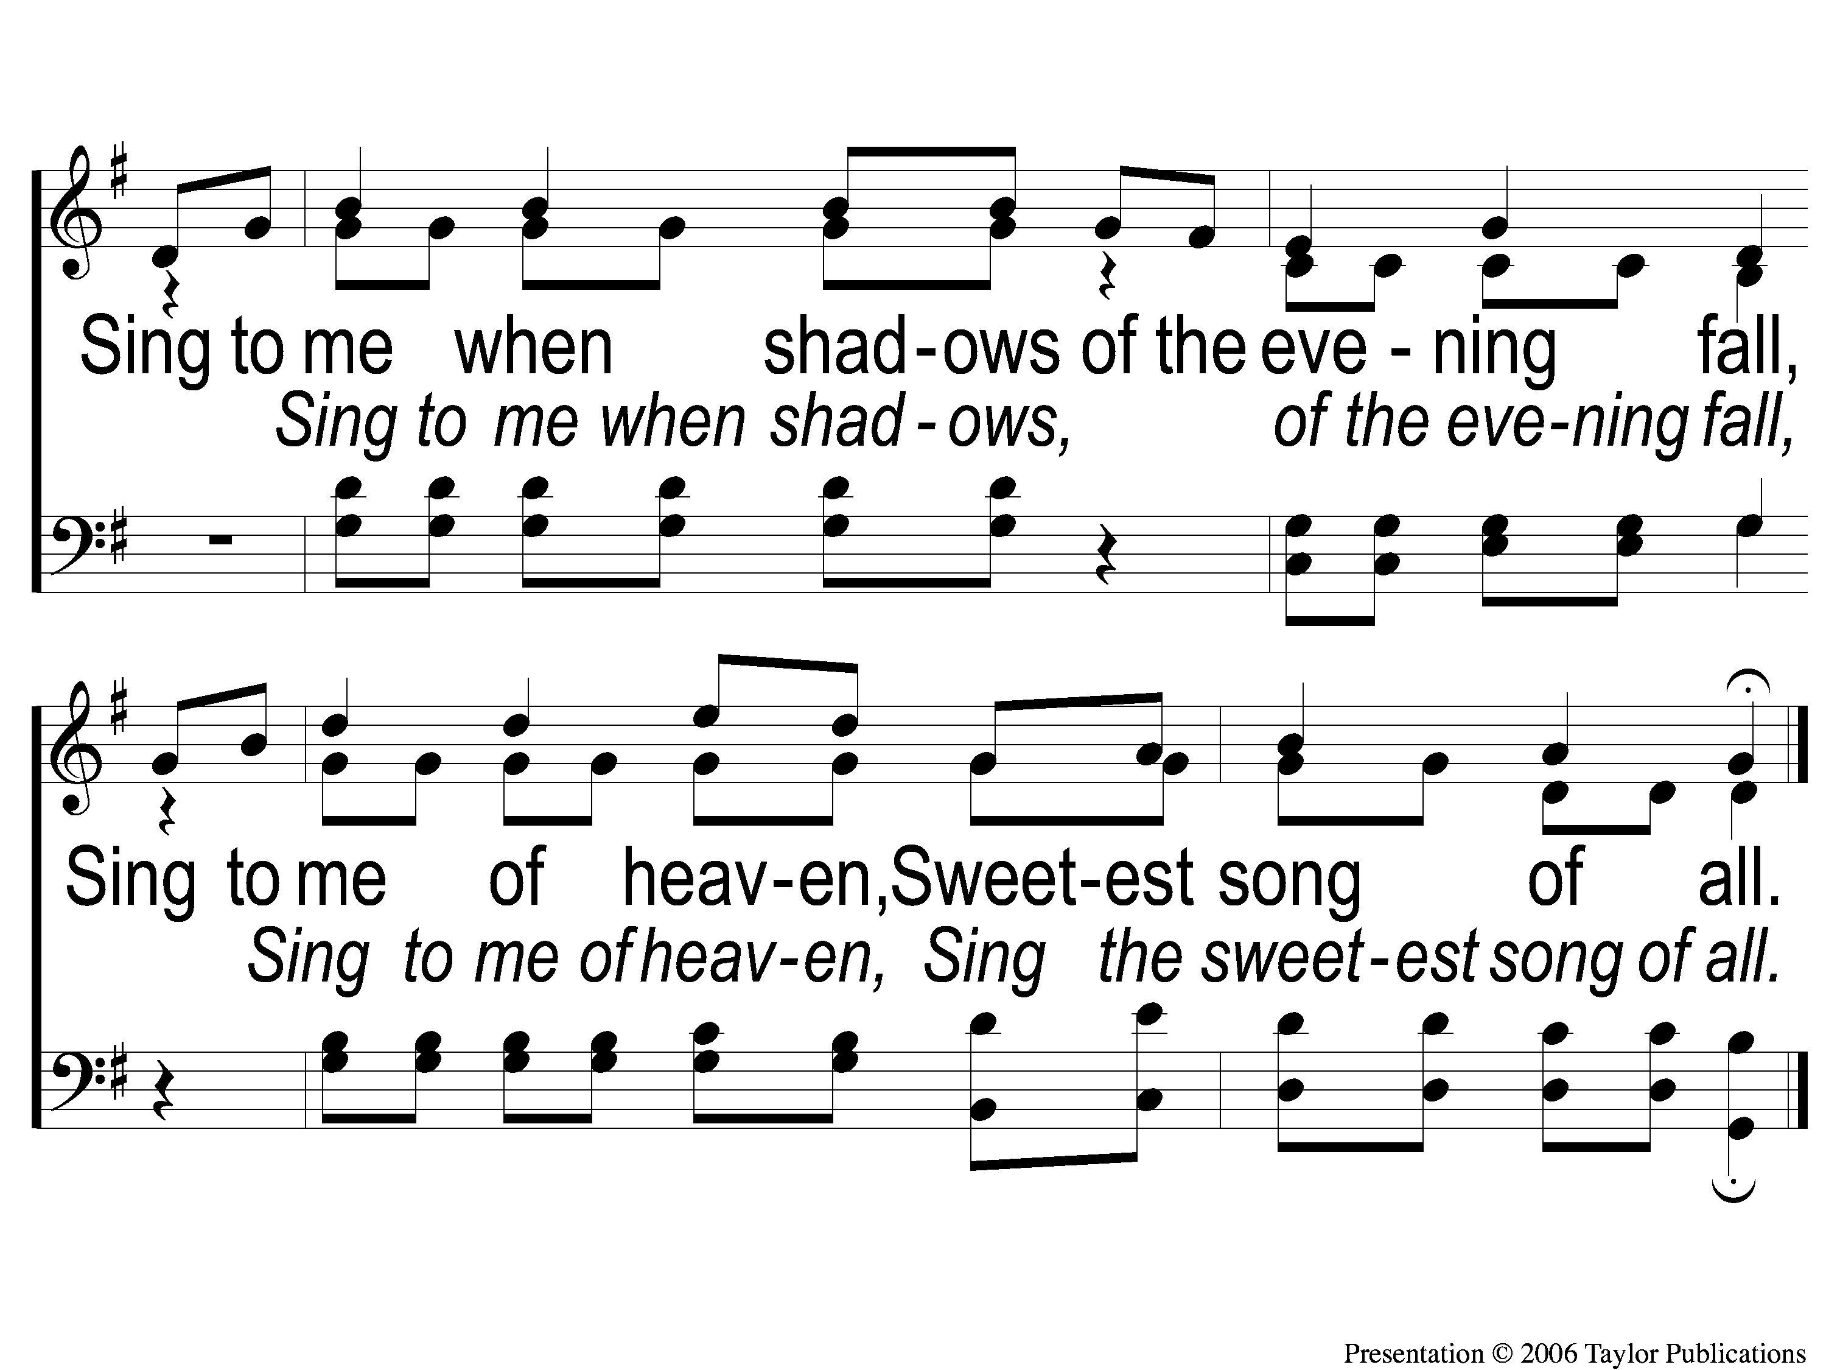
C-2 Sing to Me of Heaven
Sing To Me of Heaven
716

Slide 27
2-1 Sing to Me of Heaven
Sing To Me of Heaven
716

Slide 28
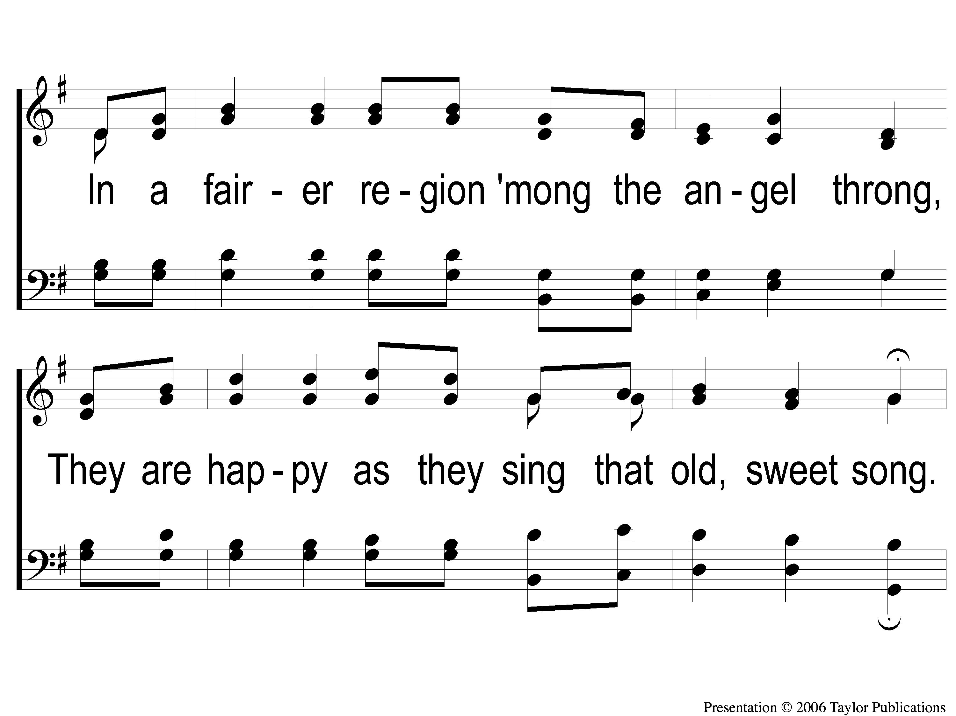
2-2 Sing to Me of Heaven
Sing To Me of Heaven
716

Slide 29
C-1 Sing to Me of Heaven
Sing To Me of Heaven
716

Slide 30
C-2 Sing to Me of Heaven
Sing To Me of Heaven
716

Slide 31
3-1 Sing to Me of Heaven
Sing To Me of Heaven
716

Slide 32
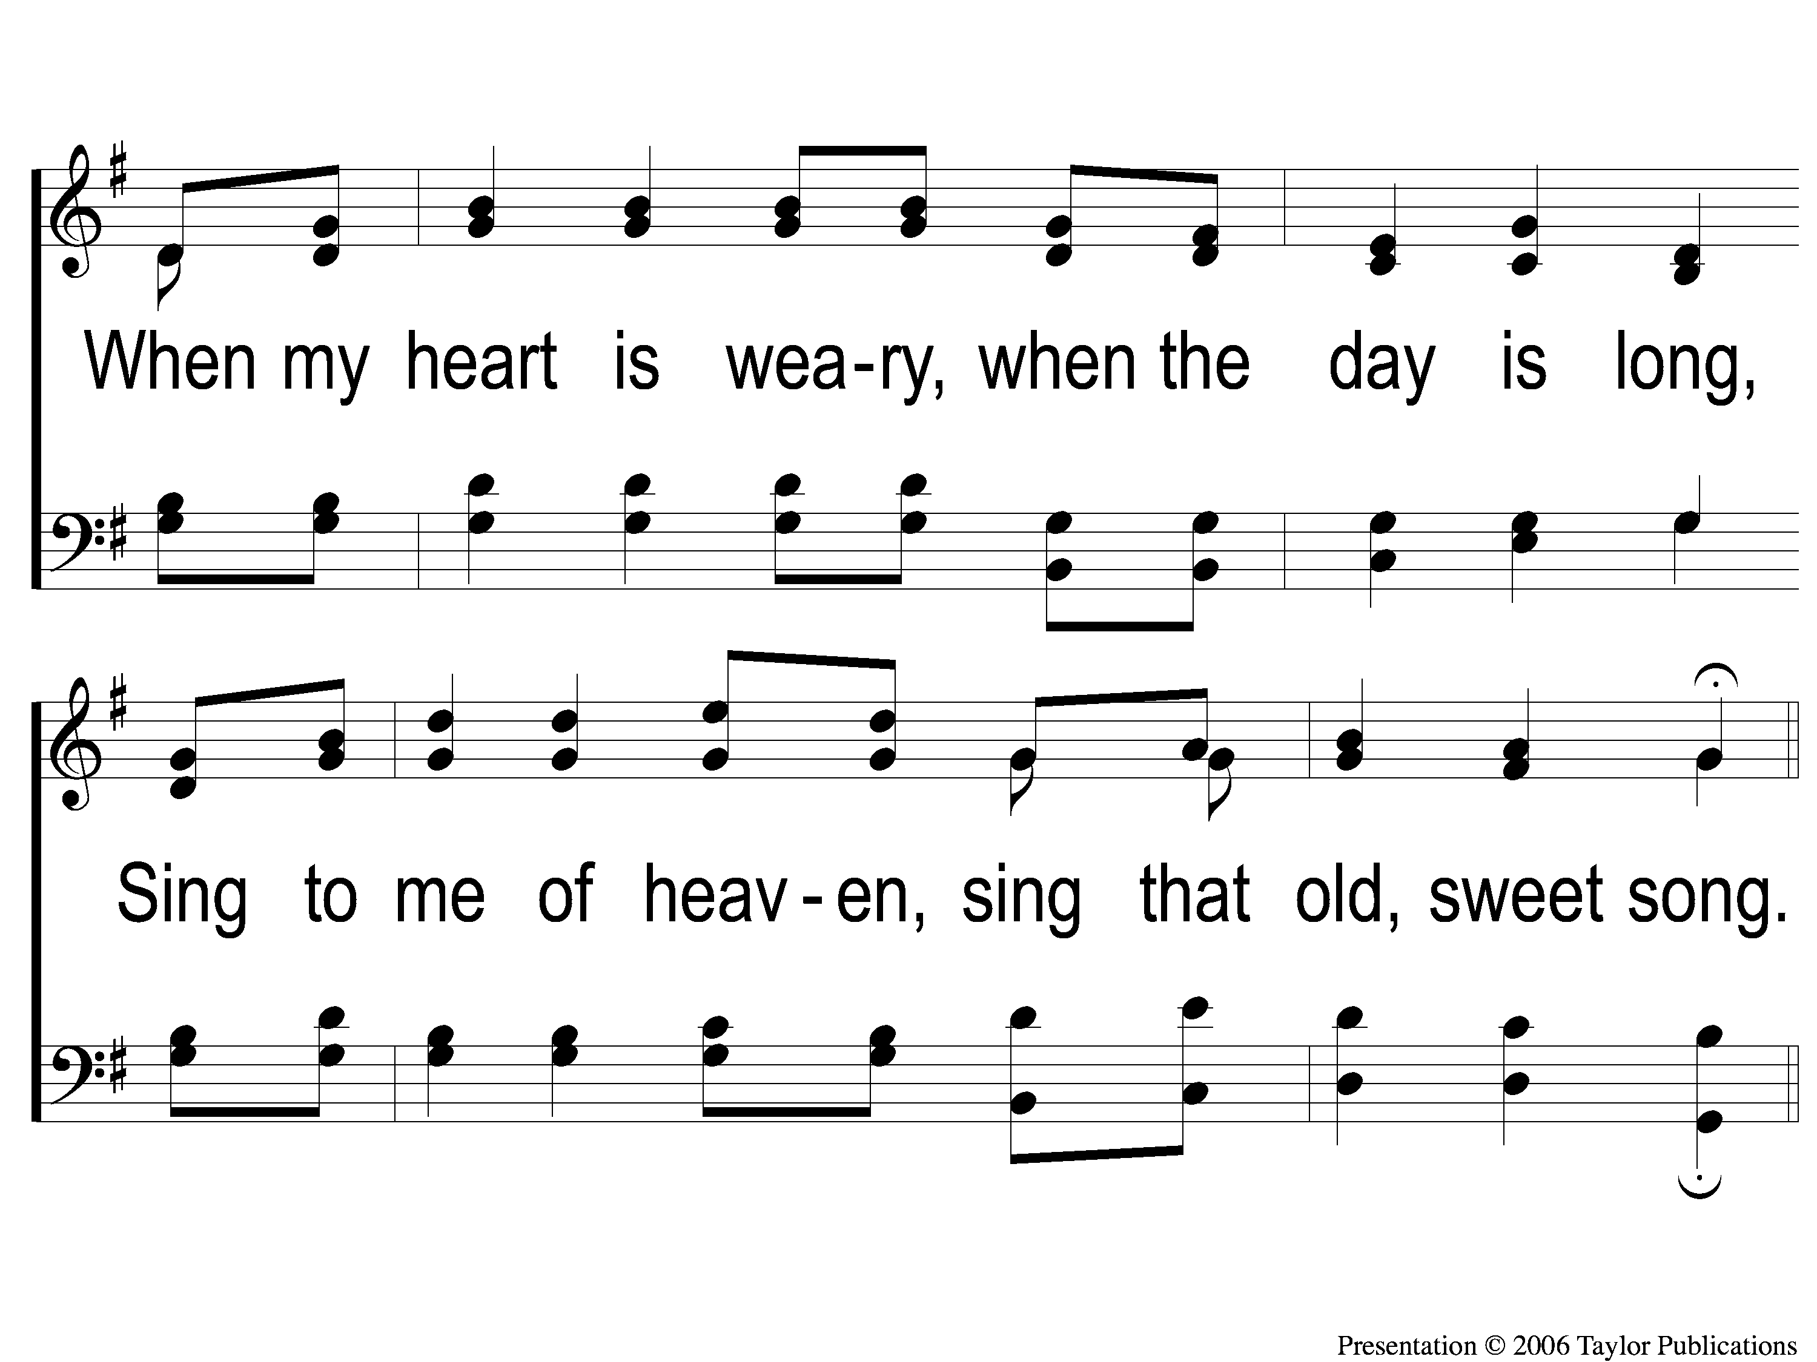
3-2 Sing to Me of Heaven
Sing To Me of Heaven
716

Slide 33
C-1 Sing to Me of Heaven
Sing To Me of Heaven
716

Slide 34
C-2 Sing to Me of Heaven
Sing To Me of Heaven
716

Slide 36
Personal: “I have been crucified”
“Truly, truly, I say to you, unless a grain of wheat falls into the earth and dies, it remains alone; but if it dies, it bears much fruit. “He who loves his life loses it, and he who hates his life in this world will keep it to life eternal. (John 12:24-25)

Slide 37
Personal: “I have been crucified”
Or do you not know that all of us who have been baptized into Christ Jesus have been baptized into His death? Therefore, we have been buried with Him through baptism into death, so that as Christ was raised from the dead through the glory of the Father, so we too might walk in newness of life.

Slide 38
Personal: “I have been crucified”
For if we have become united with Him in the likeness of His death, certainly we shall also be in the likeness of His resurrection, knowing this, that our old self was crucified with Him, in order that our body of sin might be done away with, so that we would no longer be slaves to sin; or he who has died is freed from sin. (Romans 6:3-7)

Slide 39
Personal: “I have been crucified”
“And he who does not take his cross and follow after Me is not worthy of Me. “He who has found his life will lose it, and he who has lost his life for My sake will find it. (Matthew 10:38-39)

Slide 40
Personal: “I have been crucified”
But may it never be that I would boast, except in the cross of our Lord Jesus Christ, through which the world has been crucified to me, and I to the world. (Galatians 6:14)

Slide 41
Partnership: “I have been crucified with Christ”
For if we died with Him, we will also live with Him;
If we endure, we will also reign with Him;
If we deny Him, He also will deny us;
If we are faithless, He remains faithful, for He cannot deny Himself.
(2 Timothy 2:11-13)

Slide 42
Priority: “it is no longer I who live, but Christ lives in me”
For those whom He foreknew, He also predestined to become conformed to the image of His Son, so that He would be the firstborn among many brethren; (Romans 8:29)

Slide 43
Purpose: “and the life which I now live in the flesh I live by the faith of the Son of God”

Slide 44
Purchased: “who loved me and gave himself for me.”
Or do you not know that your body is a temple of the Holy Spirit who is in you, whom you have from God, and that you are not your own? For you have been bought with a price: therefore glorify God in your body. (1 Corinthians 6:19-20)

